Slide 1
MALE GENITAL SYSTEM PATHOLOGY
Dr. Jihad A. Ahmed
BVMS; MSc; PhD Animal Pathology

Slide 2
Anatomy of the testes.
The testes (testicles) are the male gonads, paired ovoid reproductive glands that produce sperms (spermatozoa) and male hormones, primarily testosterone.
The testes are suspended in the scrotum by the spermatic cords, with the left testis usually suspended (hanging) more inferiorly than the right testis.
The epididymis is attached to the posteroinferior surface of the testes, this is important in distinguishing between swellings of the two parts.

Slide 3
Anatomy of the testes.
The surface of each testis is covered by the visceral layer of the tunica vaginalis, except where the testis attaches to the epididymis and spermatic cord.
The tunica vaginalis is a closed peritoneal sac partially surrounding the testis, which represents the closed-off distal part of the embryonic processus vaginalis. The visceral layer of the tunica vaginalis is closely applied to the testis, epididymis, and inferior part of the ductus deferens.

Slide 4
Continued….
The testes have a tough fibrous outer surface, the tunica albuginea, that thickens into a ridge on its internal, posterior aspect as the mediastinum of the testis.
From this internal ridge, fibrous septa extend inward between lobules of minute but long and highly coiled seminiferous tubules in which the sperms are produced.
The seminiferous tubules are joined by straight tubules to the rete testis (L. rete, a net), a network of canals in the mediastinum of the testis.

Slide 5
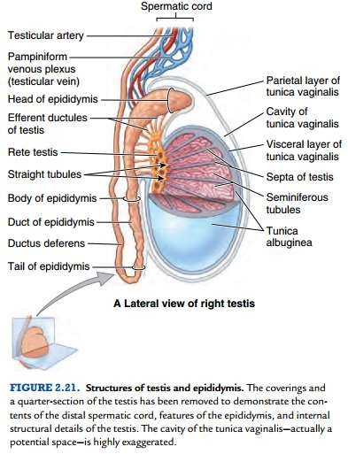
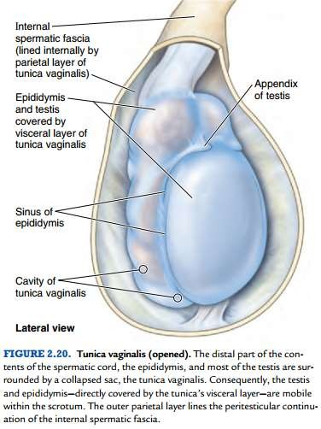

Slide 6
Continued….
During its development, each testis descends from the posterior abdominal wall to the scrotum, carrying with it a covering layer of peritoneum which forms the tunica vaginalis, a closed serous cavity around the testis. Blood vessels and lymphatics enter and leave the testis on its posterior surface at the hilum, which is not covered by tunica vaginalis.
The descent from the abdominal wall starts by the 7th week. By the 12th week, the testis is in the pelvis, and by 28 weeks (7th month), it lies close to the developing deep inguinal ring. The testis begins to pass through the inguinal canal during the 28th week and takes approximately 3 days to traverse it. Approximately 4 weeks later, the testis enters the scrotum

Slide 7
Continued….
Blood is supplied by the spermatic artery, a branch of the aorta, which passes along the spermatic cord. The venous return surrounds the spermatic artery as a network of intercommunicating veins, the pampiniform plexus. This plexus becomes the main testicular vein which, on the right side, drains to the inferior vena cava and, on the left, joins the left renal vein. Lymphatic drainage of the testis is to the iliac and para-aortic lymph nodes.

Slide 8
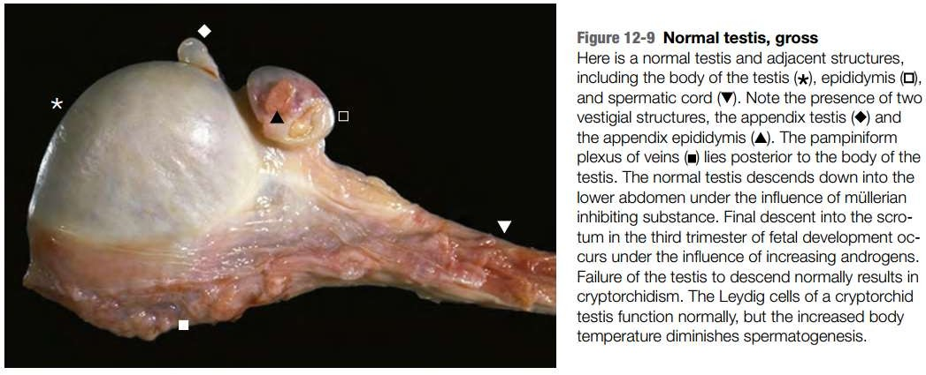
Robbins and Cotran, Atlas of Pathology, 3rd edition, Page 310

Slide 9
Histology of the testes.
The seminiferous tubules are formed of a lamellar connective tissue membrane.
In the adult, the cells lining the seminiferous tubules are of 2 types:
1. Spermatogonia or germ cells which produce spermatocytes (primary and secondary), spermatids and mature spermatozoa.

Slide 10
Continued….
2. Sertoli cells which are larger and act as supportive cells to germ cells, they secrete androgen binding protein (ABP), which keeps a high concentration of testosterone in the germ cell environment.
The seminiferous tubules have several layers of cells; the outermost layer consists the Spermatogonia, these divide to form the next layer i.e. of primary spermatocytes these divide to form the secondary spermatocytes

Slide 11
Continued….
The fibrovascular stroma present between the seminiferous tubules contains varying number of interstitial cells of Leydig.
Leydig cells have abundant cytoplasm containing lipid granules and elongated Reinke’s crystals. These cells are the main source of testosterone and other androgenic hormones in males.

Slide 12
The location of the testes in the scrotum is important for sperm production, which is optimal at 2°C to 3°C below body temperature (35°C to 37.4°C). Two mechanisms maintain the temperature of the testes at a level consistent with sperm production.
One is the pampiniform plexus of testicular veins that surround the testicular artery. This plexus absorbs heat from the arterial blood, cooling it as it enters the testes.
The other is the dartos and cremaster muscles, which respond to decreases in testicular temperature by moving the testes closer to the body

Slide 13
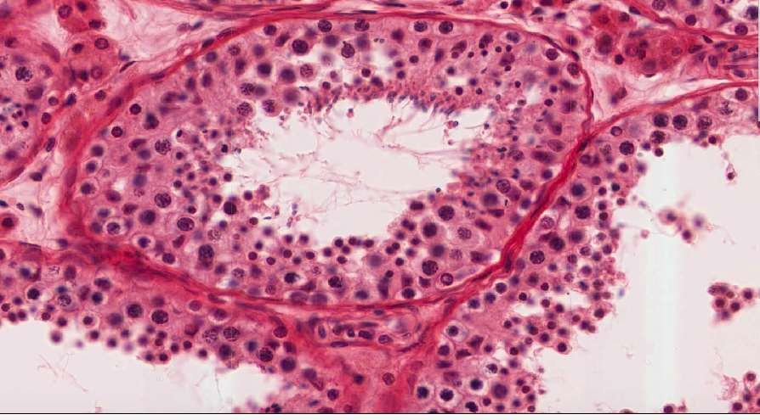

Slide 14
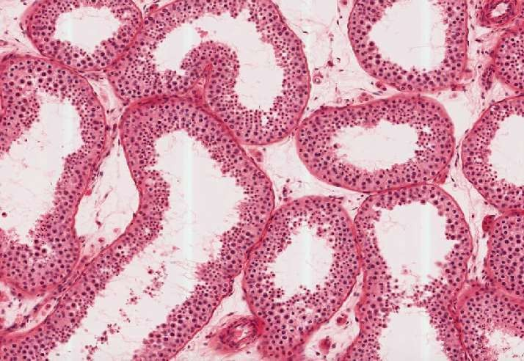

Slide 15
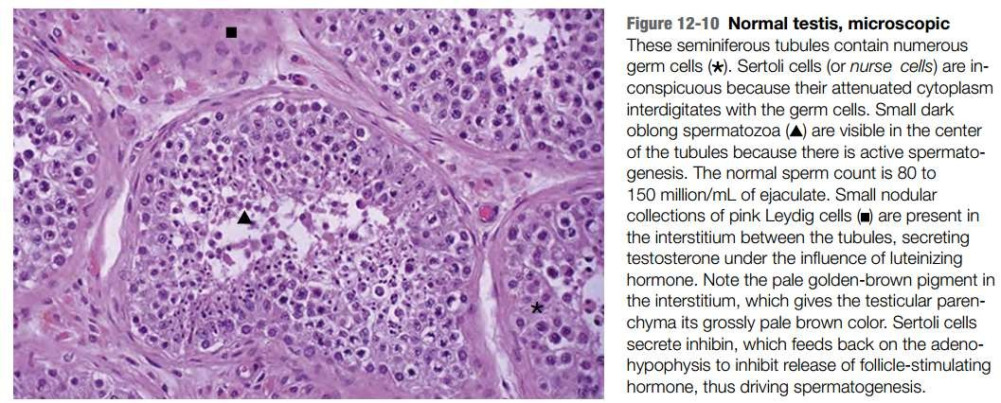
Robbins and Cotran, Atlas of Pathology, 3rd edition, Page 311

Slide 16
Congenital anomalies of the testis.
Cryptorchidism.
Cryptorchidism is a complete or partial failure of the intra-abdominal testes to descend into the scrotal sac and is associated with testicular dysfunction and an increased risk of testicular cancer.
Testicular descent occurs in two morphologically and hormonally distinct phases;

Slide 17
During the first transabdominal, phase, the testis comes to lie within the lower abdomen or brim of the pelvis. This phase is believed to be controlled by a hormone called müllerian inhibiting substance.
In the second inguinoscrotal, phase, the testes descend through the inguinal canal into the scrotal sac. This phase is androgen-dependent and is possibly mediated by androgen-induced release of calcitonin gene related peptide from the genitofemoral nerve.

Slide 18
Although testes may arrest anywhere along their pathway of descent, the most common site is in the inguinal canal; arrest within the abdomen is uncommon, accounting for approximately 5% to 10% of cases.
Even though testicular descent is controlled by hormonal factors, cryptorchidism is only rarely associated with a well-defined hormonal disorder.
This condition is unilateral in most cases, however, 25% of the cases are bilateral.

Slide 19
Morphology
Gross
The testis is small, fibrotic and firm;
Appears pale white on cut section.
Microscopy
These changes start within the 2nd year, and its marked by arrested germ cell development.
Hyalinization and thickening of the basement membrane
Prominent Leydig cells.

Slide 20
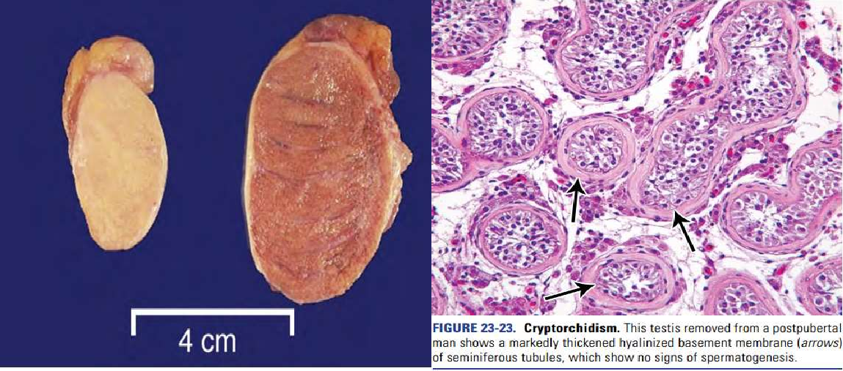

Slide 21
INFLAMMATORY CONDITIONS OF THE TESTES.
oInflammation of the testis is termed as orchitis and of epididymis is called as epididymitis; the latter being more common. A combination epididymo-orchitis may also occur.
Non-specific epididymitis and orchitis.
Is acute or chronic inflammation of the epididymis and the testes.
Commonly related to infections of the urinary tract i.e. cystititis, urthritis or prostititis, the microorganisms get to the epididymis through the vas deferens or the lymphatics.

Slide 22
Morphology
Gross
In the acute stages, testis are firm, swollen (due to edema) and congested.
In cases of gonorrhea, there may be multiple abscesses.
In chronic cases, the testis may become atrophic and fibrotic.
Microscopic
Congestion, edema and diffuse infiltration of
neutrophils.
In the early stages the infection is limited to the interstial tissue however, in the later stages, it may spread to involve the tubules and progress to formation of an abscess or complete suppurative necrosis of the entire epididymis.
From the epididymis, the reaction spreads to the testis to evoke a similar response.

Slide 23
Granulomatous (Autoimmune) orchitis
This idiopathic form of orchitis mainly affects the middle aged men, who present with a moderately tender testicular mass and sometimes with fever.
May appear suddenly as a painless swelling similar to testicular tumor.
It is a type of Type IV hypersensitivity reaction with a non-caseating granuloma.

Slide 24
Morphology.
Gross
oAffected testis is enlarged with a thickened tunica.
The cut surface is greyish-white to tan-brown.
Microscopic
oNon-caseating granulomas that are restricted to the seminiferous tubules. The granuloma is composed of epithelioid cells (originate from Sertoli cells), neutrophils, plasma cells, some lymphocytes and large multinucleated giant cells.
oThe lesions closely resemble tubercles but differ in that the granulomatous reaction is present diffusely throughout the testis and is confined to the seminiferous tubules

Slide 25
Tuberculous epididymo-orchitis
Unilateral, painless, testicular enlargement that may clinically resemble testicular tumor.
Occurs mostly in middle aged men and is usually a secondary TB from the genitourinary tract, the lungs and the kidneys.
It starts from the epididymis and spreads to the testis.
It manifests as palpable enlargement of the epididymis and beading of the vas deferens, with confluent caseating granulomas.

Slide 26
Morphology
Gross. – discrete, yellowish caseating necrotic areas. Chronically may cause discharging sinuses on the scrotal skin.
Microscopic - Caseating granulomas and mass destruction of the epididymis.

Slide 27
Spermatic granuloma
These are inflammatory lesions in the testis as a result of spermatozoa invasion of the stroma.
These lesion arise as a result of;
Trauma
Inflammation
Loss of ligation after a vasectomy.

Slide 28
Morphology.
Gross – the granuloma is a small nodule that measures 3mm –3cm in diameter and is firm and white-yellowish brown.
Microscopy – A granuloma that is composed of epithelioid cells, histiocytes, lymphocytes, macrophages and some neutrophils. The center is composed of spermatozoa and necrotic debris.
– In the late stages there’s fibroblast proliferation at the periphery and there’s hyalinization.

Slide 29
Elephantiasis.
This is the thickening of the scrotal skin and ultimately results in the enlargement of the scrotum.
This condition results from the parasitic infection, Filariasis, in which the adult form lives in the lymphatics and the larvae are found in the blood. The most common filarial worm is the Wuchereria bancrofti, which is transmitted by the culex mosquito.
Presentation; May be asymptomatic or may present with fever, tender lymphadenopathy, rash, blood eosinophilia and local pain.

Slide 30
Morphology
Gross – the affected leg and scrotum are thickened with enlargement of the lymph nodes. The affected leg also shows dilated dermal lymphatics and varicose.
Microscopy – The worm in the dead, alive or calcified form is found in the dilated lymphatics and lymph nodes.
Lymphangitis as a result of the dead or calcified form, this is evident with intense infiltration of eosinophils.
In advanced cases, chronic lymphedema with tough subcutaneous fibrosis and epidermal hyperkeratosis develops which is termed elephantiasis.

Slide 31
Varicocele.
Varicocele is the dilatation, elongation and tortuosity of the veins of the pampiniform plexus in the spermatic cord. It is of 2 types: primary (idiopathic) and secondary.
Primary or idiopathic form is more frequent and is more common in young unmarried men. It is nearly always on the left side as the loaded rectum presses the left vein. Besides, the left spermatic vein enters the renal vein at right angles while the right spermatic vein enters the vena cava obliquely.
Secondary form occurs due to pressure on the spermatic vein by enlarged liver, spleen or kidney. It is commoner in middle-aged people.

Slide 32
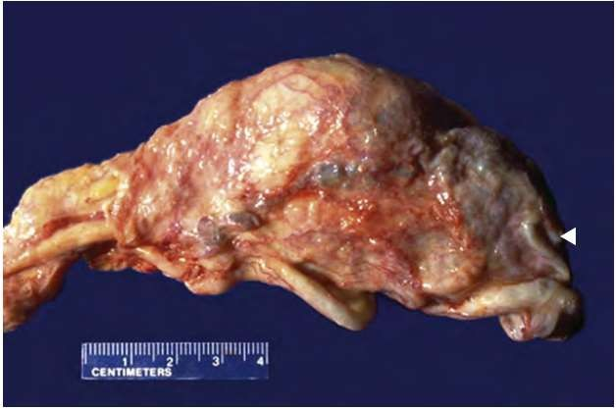
The increased blood flow makes this lesion a radiant heat device that increases the temperature of testicular tubules, inhibiting normal spermatogenesis.

Slide 33
TERATOMA
Teratomas are complex tumours composed of tissues derived from more than one of the three germ cell layers—endoderm, mesoderm and ectoderm.
Testicular teratomas are more common in infants and children and constitute about 40% of testicular tumours in infants, whereas in adults they comprise 5% of all germ cell tumours.

Slide 34
However, teratomas are found in combination with other germ cell tumours (most commonly with embryonal carcinoma) in about 45% of mixed germ cell tumours. About half the teratomas have elevated hCG or AFP levels or both.
MORPHOLOGY
Testicular teratomas are classified into 3 types:
Mature (diﬀerentiated) teratoma
Immature teratoma.
Teratoma with malignant transformation.

Slide 35
GROSSLY,
They are large, grey-white masses enlarging the involved testis.
Cut surface shows characteristic variegated appearance—grey-white solid areas, cystic and honey-combed areas, and foci of cartilage and bone.
Dermoid tumours commonly seen in the ovaries are rare in testicular teratomas.

Slide 36
MICROSCOPICALLY,
The three categories of teratomas show diﬀerent
appearances:
1. Mature (diﬀerentiated) teratoma
It is composed of disorderly mixture of a variety of well diﬀerentiated structures such as cartilage, smooth muscle, intestinal and respiratory epithelium, mucus glands, cysts lined by squamous and transitional epithelium, neural tissue, fat and bone.
This type of mature or diﬀerentiated teratoma is the most common, seen more frequently in infants and children and has favorable prognosis.

Slide 37
It is believed that all testicular teratomas in the adults are malignant.
2. Immature teratoma
Immature teratoma is composed of incompletely diﬀerentiated and primitive or embryonic tissues along with some mature elements.
Primitive or embryonic tissue commonly present are poorly-formed cartilage, mesenchyme, neural tissues, abortive eye, intestinal and respiratory tissue elements etc.
Mitoses are usually frequent.

Slide 38
3. Teratoma with malignant transformation
This is an extremely rare form of teratoma in which one or more of the tissue elements show malignant transformation.
Such malignant change resembles morphologically with typical malignancies in other organs and tissues and commonly includes rhabdomyosarcoma, squamous cell carcinoma and adenocarcinoma.

Slide 39
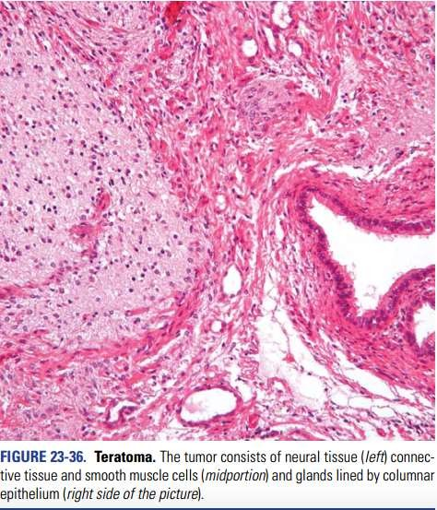

Slide 40
Thank you and good luck Reference // the materials cited from a lecture on slide share by NIRAV HITESH KUMAR VALAND

